Slide 1

Hands-On With Monte Carlo Simulations
Mohammad Soroush Barhaghi†, Younes Nejahi‡, Loren Schwiebert‡, and Jeffrey Potoff†
† Department of Chemical Engineering & Materials Science, College of Engineering,
‡ Department of Computer Science, College of Engineering, Wayne State University, Detroit, MI,
USA 48202
Notes:
1- MC simulation engine
2- Developed by potoff group & schwibert
3- Developed for running on CPU and GPU
4- CPU system size < 10,000
5- GPU system size > 10,000

Slide 2
Tutorial files
On GitHub
Git clone https://github.com/ GOMC-WSU /Workshop.git
Website https://github.com/GOMC-WSU/Workshop
To run example: copy GOMC_CPU_NVT from GOMC/bin to Workshop/NPT/SPCE/

Slide 3
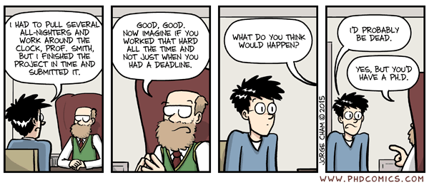
Acknowledgements
Jason Mick, Younes Nejahi, Kamel Rushaidat, Runxuan Jiang, Brock Jackman, Navendu Bhatnagar, Ganesh Kamath, Loren Schwiebert
National Science Foundation CBET-1066661, ACI-1148168, ACI-1642406
NVIDIA, Silicon Mechanics
Grid Computing at WSU

Slide 4
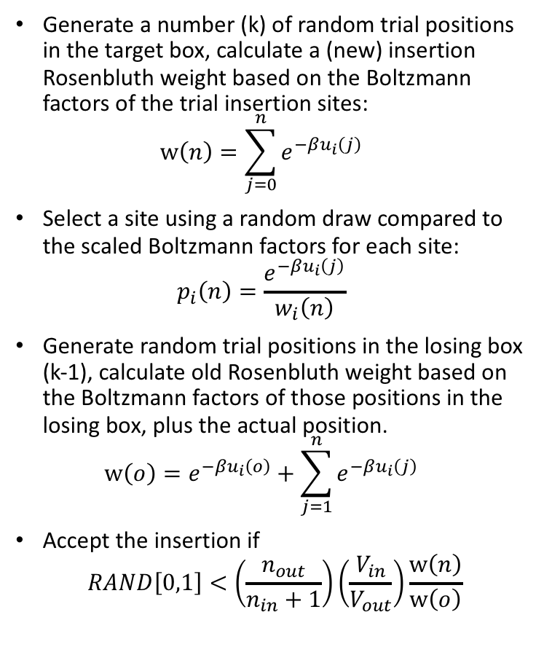
Configurational-Bias Monte Carlo
Generate a number (k) of random trial positions in the target box, calculate a (new) insertion Rosenbluth weight based on the Boltzmann factors of the trial insertion sites: $w\left(n\right)=\sum_{j=0}^{n}{e^{−βu_{i}\left(j\right)}}$
Select a site using a random draw compared to the scaled Boltzmann factors for each site: $p_{i}\left(n\right)=\frac{e^{−βu_{i}\left(j\right)}}{w_{i}\left(n\right)}$
Generate random trial positions in the losing box (k-1), calculate old Rosenbluth weight based on the Boltzmann factors of those positions in the losing box, plus the actual position. $w\left(o\right)=e^{−βu_{i}\left(o\right)}+\sum_{j=1}^{n}{e^{−βu_{i}\left(j\right)}}$
Accept the insertion if
$$RAND\left[0,1\right]<\left(\frac{n_{out}}{n_{in}+1}\right)\left(\frac{V_{in}}{V_{out}}\right)\frac{w\left(n\right)}{w\left(o\right)}$$
Trial insertion
Existing molecules

Slide 5
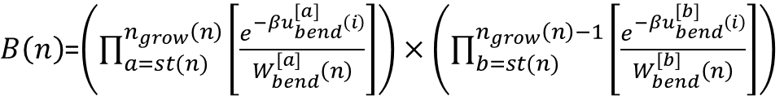
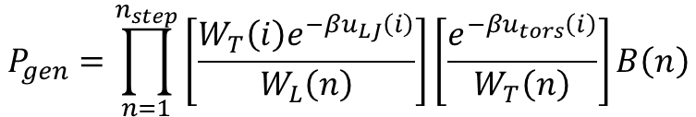
Coupled-Decoupled Configurational Bias
For n sites grown off a branch point n_{grow}(n)=n-1
$B\left(n\right)$=$\left(\prod_{a=st(n)}^{n_{grow}\left(n\right)}{\left[\frac{e^{−βu_{bend}^{[a]}\left(i\right)}}{W_{bend}^{[a]}\left(n\right)}\right]}\right)×\left(\prod_{b=st(n)}^{n_{grow}\left(n\right)−1}{\left[\frac{e^{−βu_{bend}^{[b]}\left(i\right)}}{W_{bend}^{[b]}\left(n\right)}\right]}\right)$
# of growth steps
where each step regrows all segments from a branch point
These angles ([b]) are spatially dependent on the picks from [a].
These angles ([a]) are fully independent from a spatial perspective
Torsion is coupled to nonbonded energy
i₁
a₁
t
$$P_{gen}=\prod_{n=1}^{n_{step}}{\left[\frac{W_{T}\left(i\right)e^{−βu_{LJ}\left(i\right)}}{W_{L}\left(n\right)}\right]\left[\frac{e^{−βu_{tors}\left(i\right)}}{W_{T}\left(n\right)}\right]B\left(n\right)}$$
p
b₁
f
i₂
a₂
i₃
Picking for bond angle is decoupled.
Martin and Siepmann, J. Phys. Chem B, 103, 4508 (1999)

Slide 6

Introduction to GOMC

Slide 7
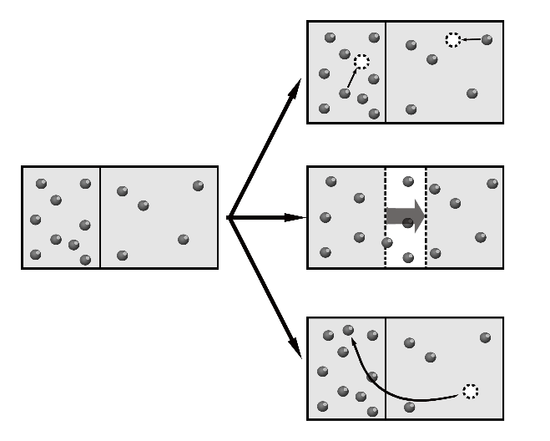
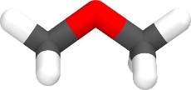
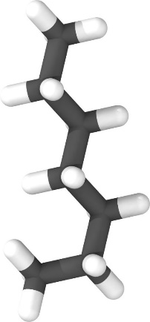

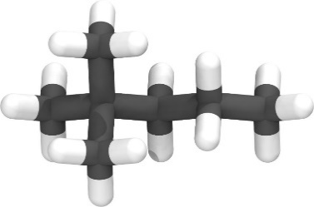
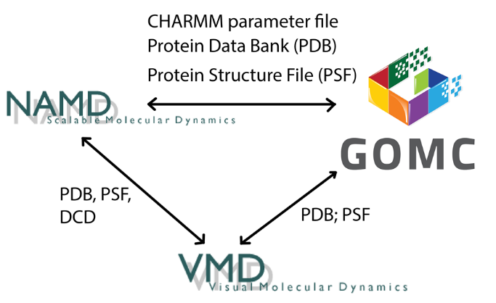
NVT, NPT,
GCMC, and GEMC
Linear, Branched,
Polar
Martini
Charmm
OPLS
Mie
Custom Potential
Moves Supported:
Displacement
Rotation
Swap (CD-CBMC)
Intra-Swap (CD-CBMC)
Regrowth (CD-CBMC)
MEMC
Intra-MEMC
CrankShaft
Volume:
Const. Ratio
Const. Area
Parallelization
CPU
OpenMP
GPU
OpenMP + GPU

Slide 8
GOMC I/O
PDB
PDB
PSF
PSF
Log
Parameter
Block Averages
Control
GCMC: Histogram

Slide 9
GOMC I/O: Input
PDB
Coordinates of all atoms
PSF
Connectivity between atoms and partial charges.
Maps atom names to atom types
Parameter
Bonded and non-bonded parameters for all atoms,
bonds, angles and dihedrals
Control
Simulation run conditions: box size, temperature
Move ratios, parameter files, etc.

Slide 10
NPT Monte Carlo Example
Create Topology and Parameter files.
Build PDB and PSF files.
Equilibrate the SPC/E water at 300 K using NVT ensemble.
Simulation of SPC/E water at 300 K and 1.0 bar, using equilibrated system.
Use the example files to run simulation to calculate the average energy and radial distribution function.

Slide 11
Building new molecules
Need atomic coordinates of the molecule of interest in PDB format (provided).
Entry in topology file defining bonds between atoms, map of atom names to atom types, and partial charges.
PDB
Topology
PDB-all, PSF
Packmol
PSFGEN

Slide 12
Single PDB file
X, Y, Z coordinates
ATOM 1 H1 SPCE 1 4.665 10.828 11.349 0.00 0.00
ATOM 2 O1 SPCE 1 4.365 11.775 11.228 0.00 0.00
ATOM 3 H2 SPCE 1 4.473 12.272 12.089 0.00 0.00
END
Atom ID
Atom name
Occupancy
residue name
Residue ID
Beta

Slide 13
Topology file
RESI SPCE 0.00
GROUP
ATOM O1 OT -0.847600 ! O1
ATOM H1 HT 0.423800 ! / \
ATOM H2 HT 0.423800 ! H1 H2
BOND O1 H1 O1 H2
PATCHING FIRS NONE LAST NONE
Defines residue name
Maps atom name to atom type
Column 3 is the partial charge
Defines bonds between pairs of atoms.

Slide 14
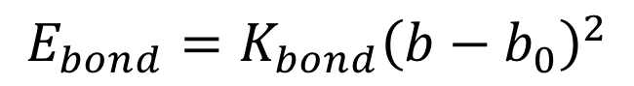
Parameter file: Bonds
EXOTIC
CHARMM
BONDS
!
!V(bond) = Kb(b - b0)**2
!
!atom type Kb(K/mole/A**2) b0 (A) description
OT HT 9999999999 1.000 ! Fixed.
BONDS
!
!V(bond) = Kb(b - b0)**2
!
!atom type Kb(Kcal/mol /A**2) b0 (A) description
OT HT 9999999999 1.000 ! Fixed.
$$E_{bond}=K_{bond}{\left(b−b_{0}\right)}^{2}$$

Slide 15
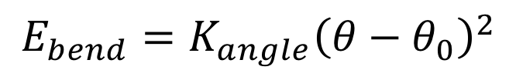
Parameter file: Angles
EXOTIC
CHARMM
ANGLES
!
!V(angle) = Ktheta(Theta - Theta0)**2!
!
!atom types Ktheta(K/mole/rad**2) Theta0(degree)
HT OT HT 9999999999 109.50 ! fixed
ANGLES
!
!V(angle) = Ktheta(Theta - Theta0)**2!
!
!atom types Ktheta(Kcal/mole/rad**2) Theta0(degree)
HT OT HT 9999999999 109.50 !fixed
$$E_{bend}=K_{angle}{\left(θ−θ_{0}\right)}^{2}$$

Slide 16
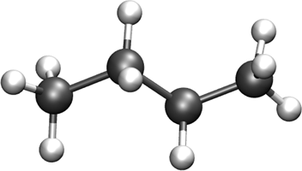
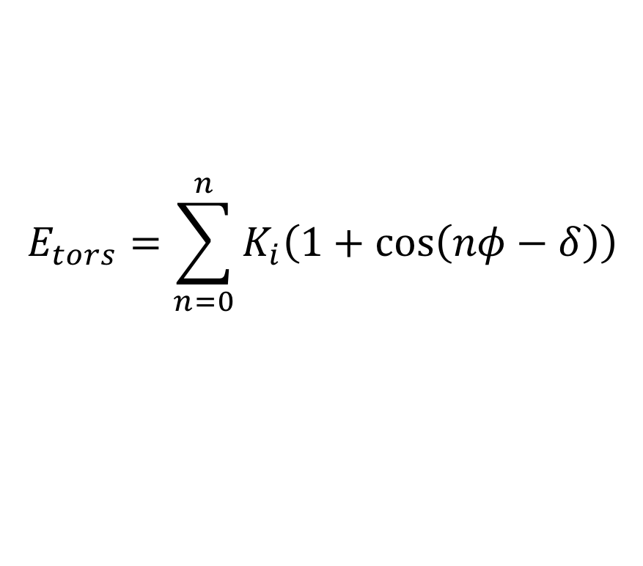
Parameter file: Dihedrals
EXOTIC
CHARMM
DIHEDRALS
!
! V(dihedral) = Kchi(1 + cos(n(chi) - delta))
!
!atom types Kchi(K/mole) n delta(degree)
X CH2 CH2 X 0.000000 0 0.0 !
X CH2 CH2 X 355.029964 1 0.0 !
X CH2 CH2 X -68.189775 2 180.0 !
X CH2 CH2 X 791.317812 3 0.0 !
DIHEDRALS
!
! V(dihedral) = Kchi(1 + cos(n(chi) - delta))
!
!atom types Kchi(Kcal/mole) n delta(degree)
X CH2 CH2 X 0.000000 0 0.0 !
X CH2 CH2 X 0.705517 1 0.0 !
X CH2 CH2 X -0.135507 2 180.0 !
X CH2 CH2 X 1.572510 3 0.0 !
$$E_{tors}=\sum_{n=0}^{n}{K_{i}\left(1+\cos\left(nφ−δ\right)\right)}$$

Slide 17
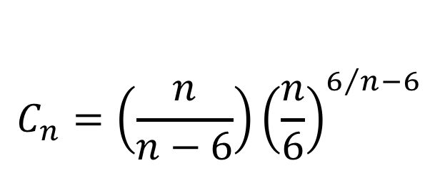
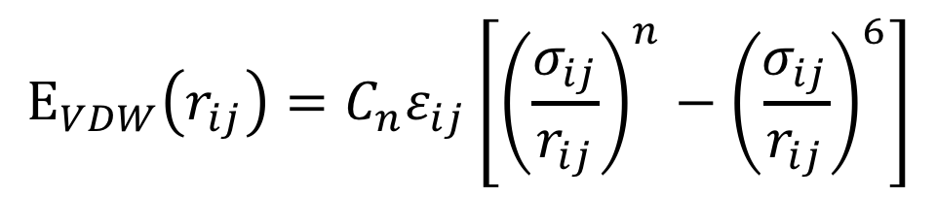
Parameter file: Nonbonded
EXOTIC
NONBONDED_MIE
!
! V(mie) = 4*eps*((sig_ij/r_ij)**n-(sig_ij/r_ij)**6)
!
!atom type eps(K) sigma(A) n eps,1-4(K) sigma,1-4(A) n,1-4 !description
CH4 78.2054 3.167 12 0.00 0.000 0 ! SPCE
HT 0.0000 0.000 12 0.00 0.000 0 ! SPCE
$$E_{VDW}\left(r_{ij}\right)=C_{n}ε_{ij}\left[{\left(\frac{σ_{ij}}{r_{ij}}\right)}^{n}−{\left(\frac{σ_{ij}}{r_{ij}}\right)}^{6}\right]$$
$$C_{n}=\left(\frac{n}{n−6}\right){\left(\frac{n}{6}\right)}^{6/n−6}$$

Slide 18
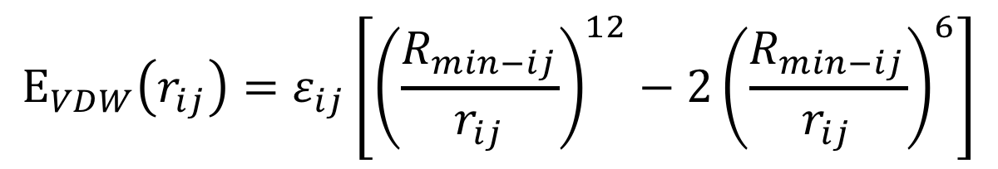
Parameter file: Nonbonded
CHARMM
NONBONDED
!
! V(LJ) = eps,i,j[(Rmin,i,j/ri,j)**12 - 2(Rmin,i,j/ri,j)**6]
!
!atom type ignored eps(Kcal/mol) Rmin/2(A) ignored eps,1-4(Kcal/mol) Rmin/2,1-4(A) !description
OT 0.0 -0.15541 1.7774185 0.0 0.00 0.00 ! SPCE
HT 0.0 0.00000 0.0000000 0.0 0.00 0.00 ! SPCE
$$E_{VDW}\left(r_{ij}\right)=ε_{ij}\left[{\left(\frac{R_{min−ij}}{r_{ij}}\right)}^{12}−2{\left(\frac{R_{min−ij}}{r_{ij}}\right)}^{6}\right]$$

Slide 19
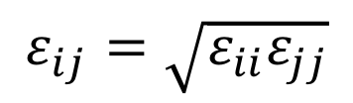
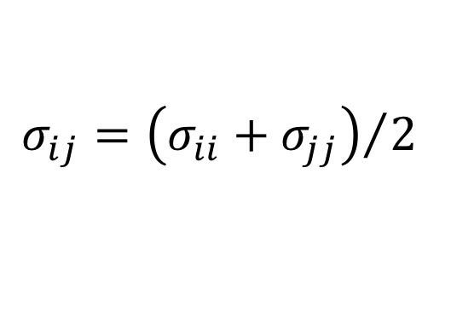
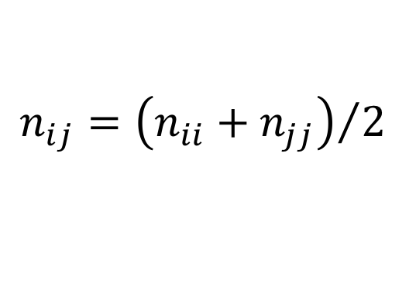
Parameter file: Nonbonded Fix (adsorbates)
EXOTIC
NBFIX_MIE
!
! V(mie) = 4*eps*((sig_ij/r_ij)**n-(sig_ij/r_ij)**6)
!
!type1 type2 eps(K) sigma(A) n eps,1-4(K) sigma,1-4(A) n,1-4 !description
C C 0.00 0.000 0 0.00 0.000 0 !
C H 0.00 0.000 0 0.00 0.000 0 !
C O 0.00 0.000 0 0.00 0.000 0 !
C ZN 0.00 0.000 0 0.00 0.000 0 !
$$σ_{ij}={\left(σ_{ii}+σ_{jj}\right)}/2$$
$$ε_{ij}=\sqrt{ε_{ii}ε_{jj}}$$
$$n_{ij}={\left(n_{ii}+n_{jj}\right)}/2$$

Slide 20
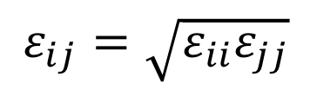
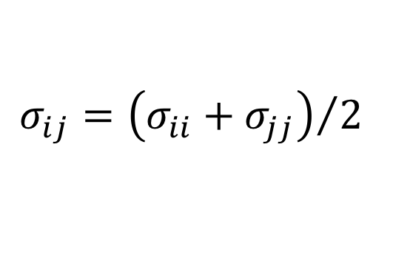
Parameter file: Nonbonded Fix (adsorbates)
CHARMM
NBFIX
!
! V(LJ) = Eps,i,j[(Rmin,i,j/ri,j)**12 - 2(Rmin,i,j/ri,j)**6]
!
! type1 type2 ignored eps(Kcal/mol) Rmin(A) ignored eps,1-4(Kcal/mol) Rmin,1-4(A) !description
C C 0.0 0.000 0.000 0.0 0.00 0.00 !
C H 0.0 0.000 0.000 0.0 0.00 0.00 !
C O 0.0 0.000 0.000 0.0 0.00 0.00 !
C ZN 0.0 0.000 0.000 0.0 0.00 0.00 !
$$σ_{ij}={\left(σ_{ii}+σ_{jj}\right)}/2$$
$$ε_{ij}=\sqrt{ε_{ii}ε_{jj}}$$
NOTE: CHARMM uses Rmin rather than Rmin/2

Slide 21
Build initial PDB configuration
300 K, 0.935 g/cm³ (liquid density); 250 molecules -> L=20.0 A
tolerance 2.7
filetype pdb
output packed_water.pdb
Structure ./singleMolecule/SPCE.pdb
number 250
inside cube 0.1 0.1 0.1 19.0
end structure
Execute this command:
./packmol <pack_box_0.inp

Slide 22
Build PSF
SPC/E Water
psfgen<<ENDMOL
topology ./top_SPCE_water.inp
segment SPCE {
pdb ./packed_water.pdb
auto angles dihedrals
first none
last none
}
Coordpdb ./packed_water.pdb SPCE
Writepsf ./START_BOX_0.psf
writepdb ./START_BOX_0.pdb
Execute this command:
vmd < ./build_psf_box_0.tcl
Notes:
Auto angles dihedrals tells psfgen to automatically generate the required angle and dihedral information.

Slide 23
Control file
eq.conf
prod.conf
Restart false
# FORCE FIELD
ParaTypeCHARMM true
Parameters ./par_SPCE_Charmm.par
# INPUT PDB
Coordinates 0 ./../build/START_BOX_0.pdb
# INPUT PSF
Structure 0 ./../build/START_BOX_0.psf
# MOVE FREQUENCY
DisFreq 0.60
RotFreq 0.30
RegrowthFreq 0.10
# BOX DIMENSION #, X, Y, Z
CellBasisVector1 0 20.00 0.00 0.00
CellBasisVector2 0 0.00 20.00 0.00
CellBasisVector3 0 0.00 0.00 20.00
Restart true
# FORCE FIELD
ParaTypeCHARMM true
Parameters ./par_SPCE_Charmm.par
# INPUT PDB
Coordinates 0 ./../Equilibration/SPCE_EQ_BOX_0_restart.pdb
# INPUT PSF
Structure 0 ./../Equilibration/SPCE_EQ_merged
# MOVE FREQUENCY
DisFreq 0.60
RotFreq 0.38
VolFreq 0.02
# BOX DIMENSION #, X, Y, Z
# CellBasisVector1 0 20.00 0.00 0.00
# CellBasisVector2 0 0.00 20.00 0.00
# CellBasisVector3 0 0.00 0.00 20.00
Notes:
Auto angles dihedrals tells psfgen to automatically generate the required angle and dihedral information.

Slide 24
GOMC I/O: LOG Output
MOVE_<box number>: move statistics
ENER_<box number>: energies
STAT_<box number>: density
Data are stored in columns, making them straightforward to extract with awk.
Quantities instantaneous values, and are defined with MTITLE, ETITLE and STITLE headers near the beginning of the log file.

Slide 25
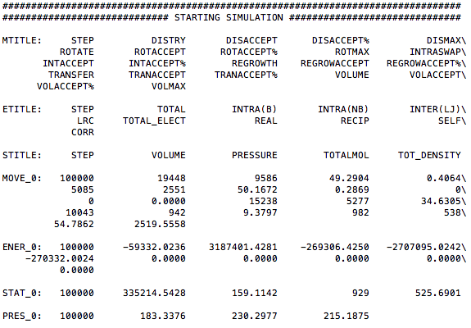
GOMC I/O: LOG Output

Slide 26
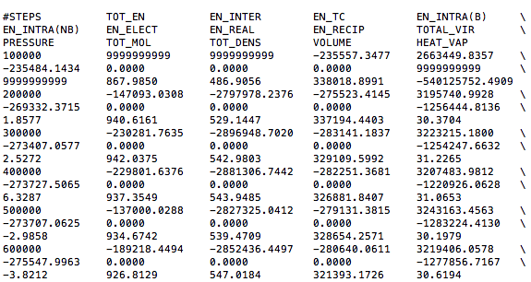
GOMC I/O: BLOCK Output

Slide 27
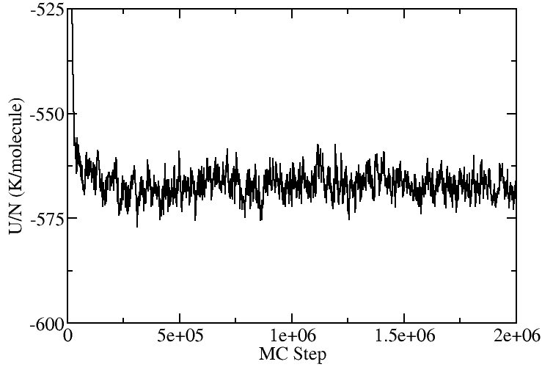
GOMC I/O: Output
Extract data using awk
awk ‘/ENER_0/ {print $2, $3}’ output_water.log > energy.dat
grep “ENER_0” output_water.log | awk {print $2, $3}’ > energy.dat

Slide 28
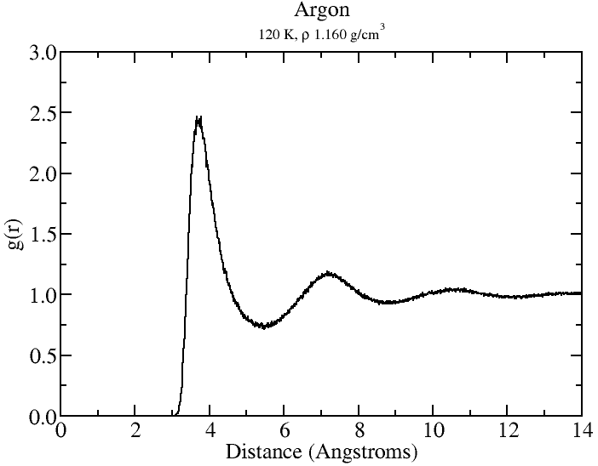
GOMC: RDF
Follow README.txt to generate RDF

Slide 29

Gibbs Ensemble Monte Carlo
Particle Displacement
Volume Exchange
Bulk liquid and vapor
External (NVT): N_{T}, V_{T}, T are constant Chemical equilibrium: μ_{L}= μ_{V}
Mechanical Equlibrium: P_{V}=P_{L}
Molecule Transfer

Slide 30
GEMC Example
Workshop/NVT_GEMC
Need to build initial configurations for two boxes.
Issuing the following commands to create START_BOX_*.pdb, *.psf
./packmol <pack_box_0.inp
./packmol <pack_box_1.inp
./build_psf_box_0.tcl or try vmd < build_psf_box_0.tcl
./build_psf_box_1.tcl or try vmd < build_psf_box_1.tcl
Could be combined into a single shell script.

Slide 31
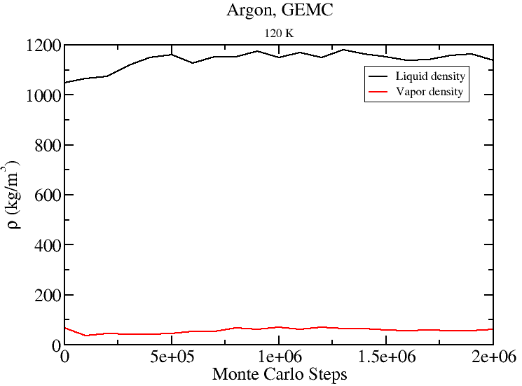
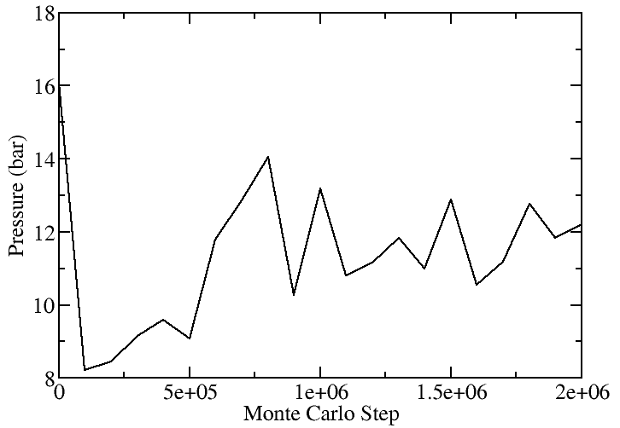

GEMC: Argon 120 K
Exclude first 500,000 MCS from block average files.
$\left\langle ρ_{liq}\right\rangle =1155.09 kg/m^{3}$; literature $\left\langle ρ_{liq}\right\rangle =1159.9 kg/m^{3}$
$\left\langle P\right\rangle =12.123 bar$; literature $\left\langle P\right\rangle =12.156 bar$

Slide 32
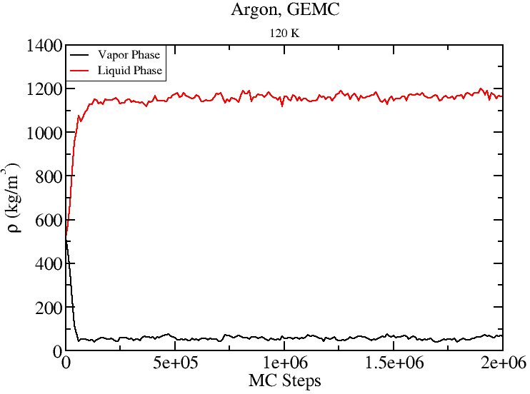
GEMC: Argon 120K
Start from 500 molecules and L=40 A
for each box.
As long as one starts in the two phase region, GEMC will form two distinct phases.
Gas
Gas
Liquid
Liquid

Slide 33
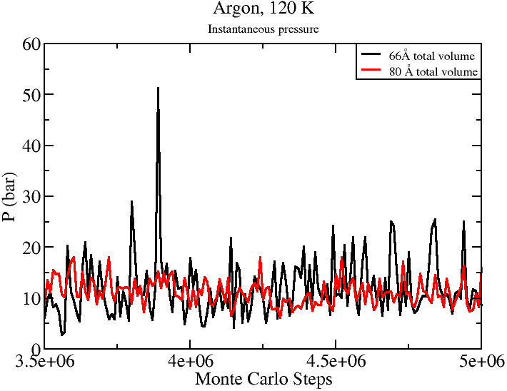
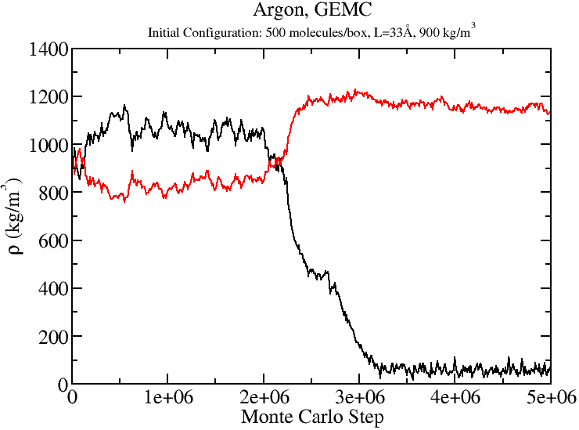
GEMC Tips
Choice of simulation parameters may effect length of equilibration required.
Number of molecules in each phase also effects the magnitude of the statistical uncertainties.

Slide 34
GEMC: Restart files
For GEMC, the “merged” PSF file written by GOMC contains the information for both boxes.
####################################
# INPUT PSF FILES
####################################
Structure 0 ../argon_T_120K/Argon_GEMC_T_120K_merged.psf
Structure 1 ../argon_T_120K/Argon_GEMC_T_120K_merged.psf

Slide 35
GEMC PDB Output
“restart” PDB contains only the coordinates for atoms in that phase.
PDB output files for each box contain coordinates for all molecules in the simulation: Argon_GEMC_T_120K_BOX_0.pdb
The occupancy column is used to designate the box to which each molecule belongs. “imaginary” molecules are given coordinates of 0,0,0.
ATOM 29 AR AR A 29 21.324 0.131 25.770 0.00 0.00
ATOM 30 AR AR A 30 29.973 1.108 36.433 0.00 0.00
ATOM 31 AR AR A 31 0.000 0.000 0.000 1.00 0.00
Unfortunately, VMD does not understand changing the number of molecules in the simulation. VMD also does not update occupancy values.

Slide 36
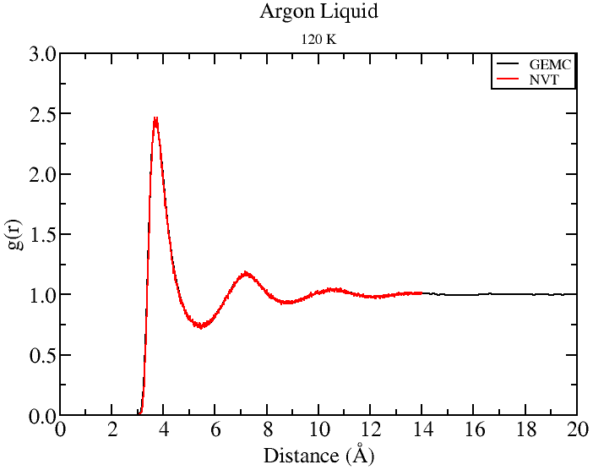
GEMC PDB Output
#set selection to ignore all molecules with 0, 0, 0 coordinates.
set AllSel1 [atomselect top "name $sel1 and x != 0.0 and y != 0.0 and z !=0.0" frame $j]
set AllSel2 [atomselect top "name $sel2 and x != 0.0 and y != 0.0 and z !=0.0" frame $j]
set BoxL [lindex $BoxDim 0 $j]
pbc set "$BoxL $BoxL $BoxL“
#calculate RDF
set temRDF [measure gofr $AllSel1 $AllSel2 delta $stepSize rmax $rcut usepbc 1]

Slide 37
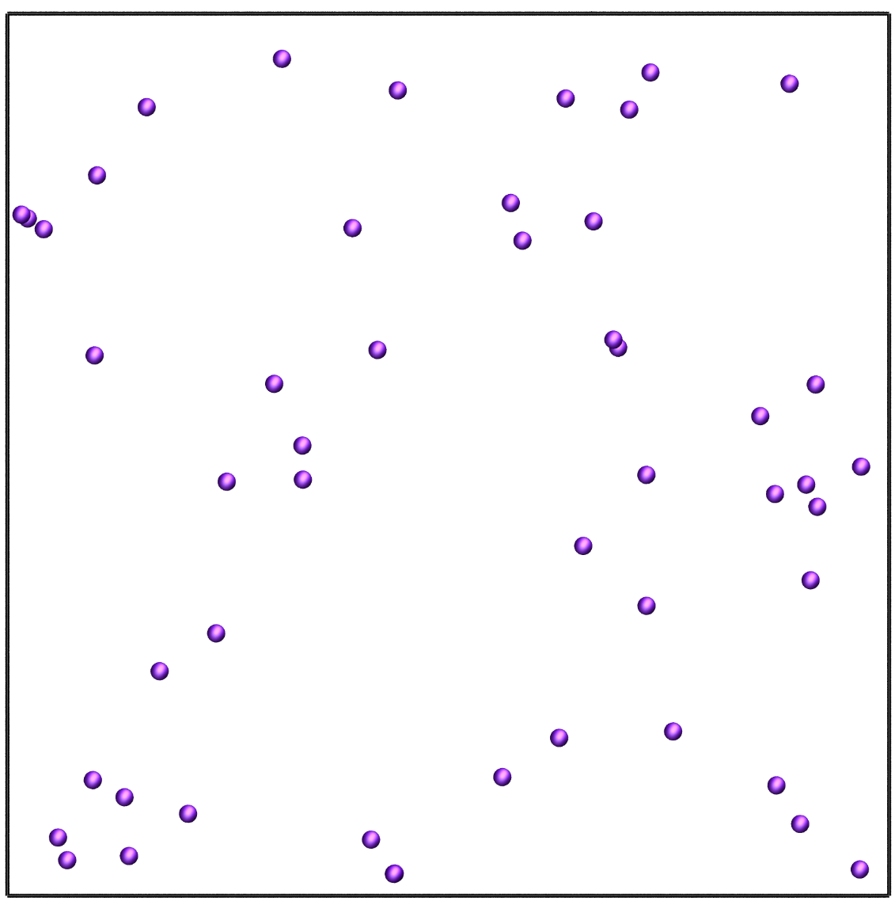
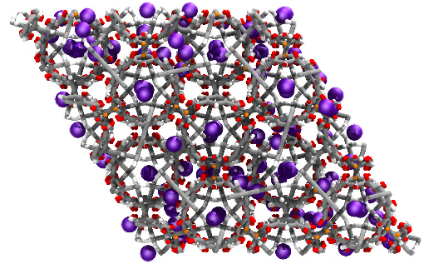
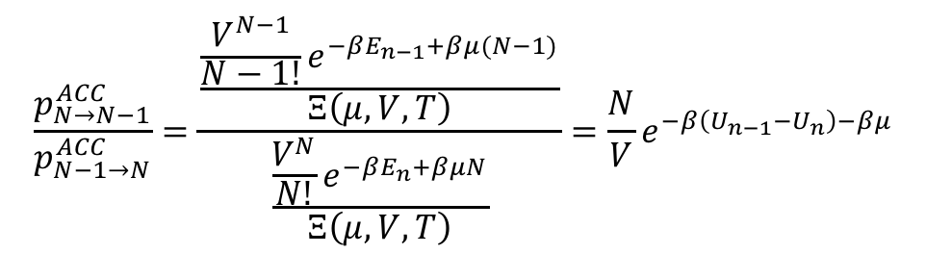
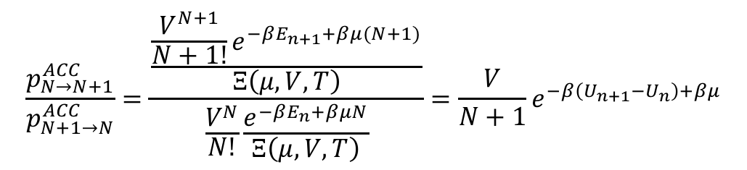
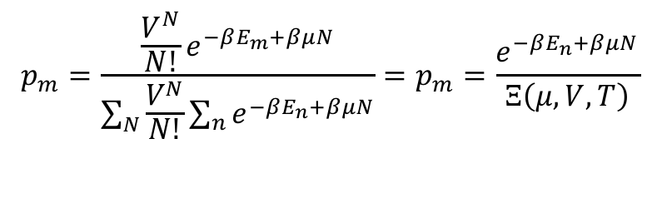
Grand Canonical Monte Carlo
External (μVT): μ, V, T are constant and imposed by reservoir on simulation box. Fluctuating: N, P, and E .
$$p_{m}=\frac{{\frac{V^{N}}{N!}e}^{−βE_{m}+βμN}}{\sum_{N}{\frac{V^{N}}{N!}\sum_{n}{e^{−βE_{n}+βμN}}}}=p_{m}=\frac{e^{−βE_{n}+βμN}}{Ξ\left(μ,V, T\right)}$$
$$\frac{p_{N→N+1}^{ACC}}{p_{N+1→N}^{ACC}}=\frac{\frac{{\frac{V^{N+1}}{N+1!}e}^{−βE_{n+1}+βμ(N+1)}}{Ξ\left(μ,V, T\right)}}{\frac{V^{N}}{N!}\frac{e^{−βE_{n}+βμN}}{Ξ\left(μ,V, T\right)}}={\frac{V}{N+1}e}^{−β\left(U_{n+1}−U_{n}\right)+βμ}$$
$$\frac{p_{N→N−1}^{ACC}}{p_{N−1→N}^{ACC}}=\frac{\frac{{\frac{V^{N−1}}{N−1!}e}^{−βE_{n−1}+βμ(N−1)}}{Ξ\left(μ,V, T\right)}}{\frac{\frac{V^{N}}{N!}e^{−βE_{n}+βμN}}{Ξ\left(μ,V, T\right)}}={\frac{N}{V}e}^{−β\left(U_{n−1}−U_{n}\right)−βμ}$$

Slide 38
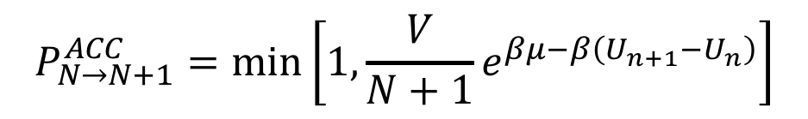
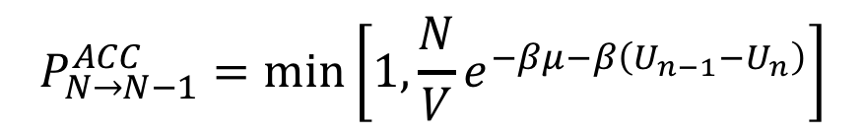
Grand Canonical Monte Carlo
Acceptance criteria for molecule swap in Grand Canonical ensemble Monte Carlo (GCMC).
$$P_{N→N+1}^{ACC}=\min\left[1, {\frac{V}{N+1}e}^{βμ−β\left(U_{n+1}−U_{n}\right)}\right]$$
$$P_{N→N−1}^{ACC}=\min\left[1, {\frac{N}{V}e}^{−βμ−β\left(U_{n−1}−U_{n}\right)}\right]$$

Slide 39
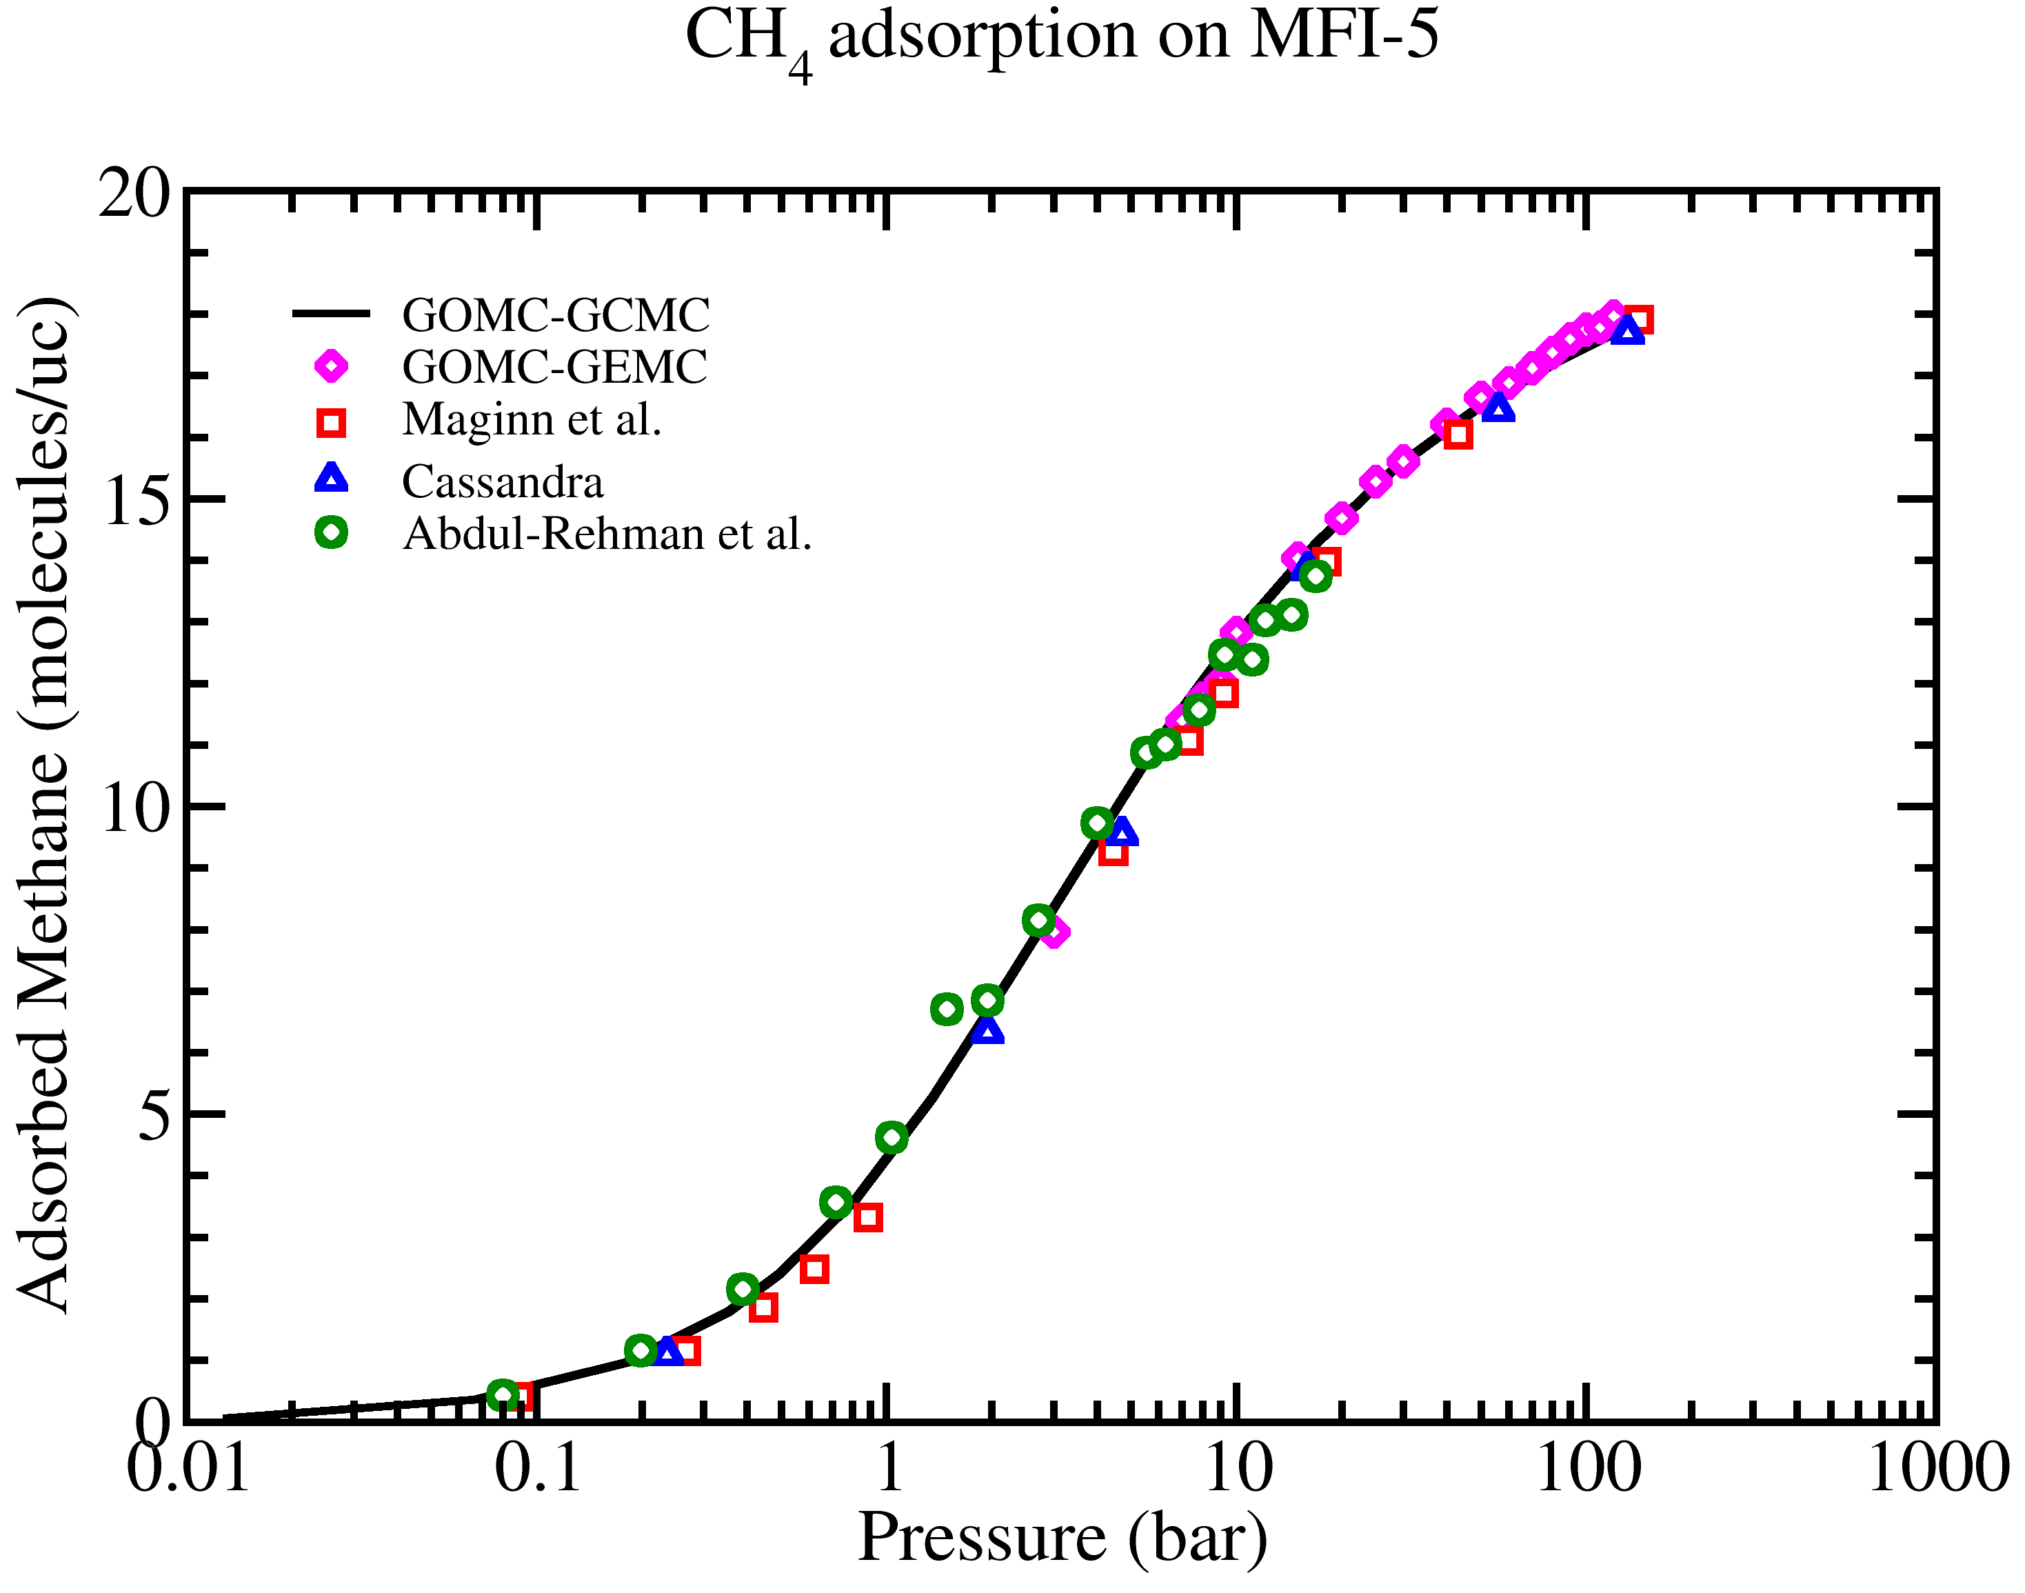
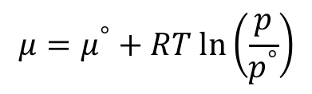
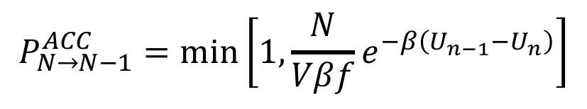
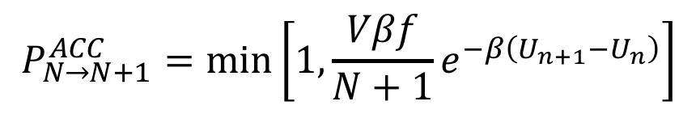
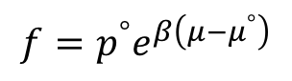
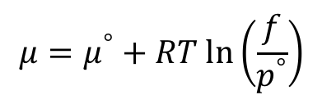
Grand Canonical Monte Carlo
For ideal gas:
$$μ=μ^{°}+RT ln\left(\frac{p}{p^{°}}\right)$$
For non-ideal gas:
$$μ=μ^{°}+RT ln\left(\frac{f}{p^{°}}\right)$$
$${{f=p}^{°}e}^{β\left(μ−μ^{°}\right)}$$
$$P_{N→N+1}^{ACC}=\min\left[1, {\frac{Vβf}{N+1}e}^{−β\left(U_{n+1}−U_{n}\right)}\right]$$
$$P_{N→N−1}^{ACC}=\min\left[1, {\frac{N}{Vβf}e}^{−β\left(U_{n−1}−U_{n}\right)}\right]$$

Slide 40
Creating PDB, PSF for reservoir:
GCMC requires two simulation boxes, one for the reservoir and the other for the adsorbent.
To prepare the reservoir, we use 1000 argon molecules in 40 Å cubic box.
tolerance 3.0
filetype pdb
output packed_argon.pdb
Structure ./singleMolecule/argon.pdb
number 1000
inside cube 0.1 0.1 0.1 38.
end structure
psfgen<<ENDMOL
topology ../topology_EDUSIF.inp
segment AR {
pdb ./packed_argon.pdb
first none
last none
}
coordpdb ./packed_argon.pdb AR
writepsf ./START_BOX_1.psf
writepdb ./START_BOX_1.pdb

Slide 41
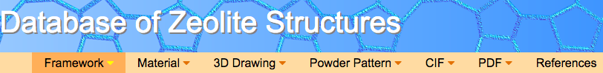

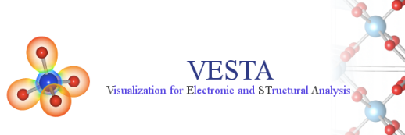
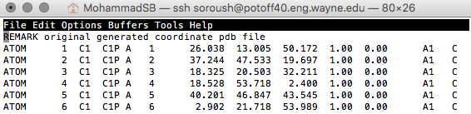
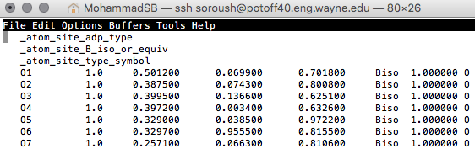
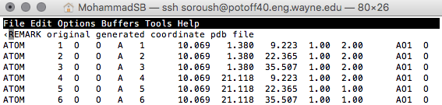
Creating PDB for adsorbent:
Beta = 0: Displace, Rotate, Intra-swap, Swap, regrowth
Beta = 1: Fix
Beta = 2: Displace, Rotate, Intra-swap, regrowth
Beta Value
Tcl script in VMD
Notes:
Code uses the PDB values in the PDB to determine if a particular molecule should be moved or not.

Slide 42


Creating PDB for adsorbent:
To generate the PDB file, each atom will be considered its own molecule. Assign resname using atom name.
Download the crystal structure.
Use VESTA to:
Extend the unit cell by factor of 2.
Remove the bonds.
Export the structure as PDB file.
Use convert script to assign resname and resid based on atom name.

Slide 43
Building “Base”
vmd < convert_VESTA_PDB.tcl
vmd < build_EDUSIF_auto.tcl
vmd < setBeta.tcl

Slide 44


Creating PSF for adsorbent:
To generate the PSF file, separate each residue in each file and use psfgen to generate PSF file.
Use build scripts (convert_VESTA_PDB.tcl, build_EDUSIF_auto.tcl) to separate each residue type and generate PDB files.
Set beta value to 1 in PDB by using setBeta.tcl script.

Slide 45
Creating PSF for adsorbent:
package require psfgen
topology ../topology_EDUSIF.inp
exec grep -w "Zn" EDUSIF_clean_min_modified.pdb > ZN.pdb
exec grep -w "C" EDUSIF_clean_min_modified.pdb > C.pdb
exec grep -w "O" EDUSIF_clean_min_modified.pdb > O.pdb
exec grep -w "H" EDUSIF_clean_min_modified.pdb > H.pdb
segment Zn {
pdb ZN.pdb
first none
last none
}
segment C {
pdb C.pdb
first none
last none
}
segment O {
pdb O.pdb
first none
last none
}
segment H {
pdb H.pdb
first none
last none
}
coordpdb ZN.pdb Zn
coordpdb C.pdb C
coordpdb O.pdb O
coordpdb H.pdb H
writepsf IRMOF_1_BOX_0.psf
writepdb IRMOF_1_BOX_0.pdb

Slide 46
IRMOF-1 Topology file:
MASS 1 O 15.999 O !
MASS 2 C 12.0107 C !
MASS 3 H 1.00794 H !
MASS 4 ZN 65.38 ZN !
MASS 5 AR 39.948 AR !
DEFA FIRS none LAST none
AUTOGENERATE ANGLES DIHEDRALS
RESI C 0.000
GROUP
ATOM C C 0.000
PATCHING FIRS NONE LAST NONE
RESI H 0.000
GROUP
ATOM H H 0.000
PATCHING FIRS NONE LAST NONE
RESI O 0.000
GROUP
ATOM O O 0.000
PATCHING FIRS NONE LAST NONE
RESI Zn 0.000
GROUP
ATOM Zn ZN 0.000
PATCHING FIRS NONE LAST NONE
RESI AR 0.00 ! argon
GROUP
ATOM AR AR 0.00 ! *
PATCHING FIRS NONE LAST NONE
END

Slide 47

Control file: GCMC
ParaTypeEXOTIC true
Parameters ./par_IRMOF_NobleGases_Mie.par
# INPUT PDB, PSF FILES
Coordinates 0 ../build/base/IRMOF_1_BOX_0.pdb
Coordinates 1 ../build/reservoir/START_BOX_1.pdb
Structure 0 ../build/base/IRMOF_1_BOX_0.psf
Structure 1 ../build/reservoir/START_BOX_1.psf
# MOVE FREQUENCY
DisFreq 0.20
RotFreq 0.00
IntraSwapFreq 0.20
RegrowthFreq 0.0
SwapFreq 0.60
# Chemical Potential/Fugacity
Fugacity AR 5.0
Fugacity C 0
Fugacity H 0
Fugacity O 0
Fugacity ZN 0
# BOX DIMENSION #, X, Y, Z
CellBasisVector1 0 36.8140 0.0 0.0
CellBasisVector2 0 18.2583 31.9880 0.0
CellBasisVector3 0 18.2712 10.5596 30.1748
CellBasisVector1 1 40.00 0.00 0.00
CellBasisVector2 1 0.00 40.00 0.00
CellBasisVector3 1 0.00 00.00 40.00
# OutHistSettings
DistName dis
HistName his
RunNumber 1
RunLetter a
SampleFreq 200
Vector1$=\left(1, 0, 0\right)x$
Vector2 $=$ $\left(\cos{γ}, \sqrt{1−{\left(\cos{γ}\right)}^{2}}, 0\right)y$
Vector3 $=$ $\left(\cos{β}, \frac{\cos{α}−\cos{β\cos{γ}}}{\sqrt{1−{\left(\cos{γ}\right)}^{2}}},\sqrt{1−{\left(\cos{β}\right)}^{2}−{\left(\frac{\cos{α}−\cos{β\cos{γ}}}{\sqrt{1−{\left(\cos{γ}\right)}^{2}}}\right)}^{2}} \right)z$

Slide 48

Argon Adsorption in IRMOF-1

Slide 49

GOMC on Multicore and GPU

Slide 50
Acknowledgements
Jason Mick, Younes Nejahi, Kamel Rushaidat, Runxuan Jiang, Brock Jackman, Navendu Bhatnagar, Ganesh Kamath, Loren Schwiebert
National Science Foundation CBET-1066661, ACI-1148168, ACI-1642406
NVIDIA, Silicon Mechanics
Grid Computing at WSU

